Slide 1



Face Recognition Progression: Synthetic Images to Vulnerabilities
Dr. Akshay Agarwal¹, Chaitanya Roygaga²
¹IISER Bhopal, India ²Lehigh University, USA
GitHub:
Dr. Akshay Agarwal
Chaitanya Roygaga

Slide 2

Drive Link

Slide 3
Resources
Link to pdf of this presentation: https://tinyurl.com/3s5b82y2
Dataset Embeddings and Model scores: https://tinyurl.com/5hkpb8ry
Sample Dataset Images: https://tinyurl.com/5n7ewek6
AdaFace pretrained weights: https://tinyurl.com/3sbhrcym
Analysis:
  Visualizing feature maps: https://tinyurl.com/y8zbp5u9
  Visualizing model embeddings: https://tinyurl.com/2rnjwfpp

Slide 4
Face Recognition Progression
Motivations
and
Models, Datasets
Motivations, Models, Datasets.
Model Exploration over
Datasets of Different Distributions.
Face Recognition Performance and Analysis on Real Datasets.
Face Recognition Performance and Analysis on Synthetic Datasets.
Face Recognition Performance and Analysis on Morphed Faces.
Face Recognition Performance and Analysis on Adversarial Datasets.

Slide 5
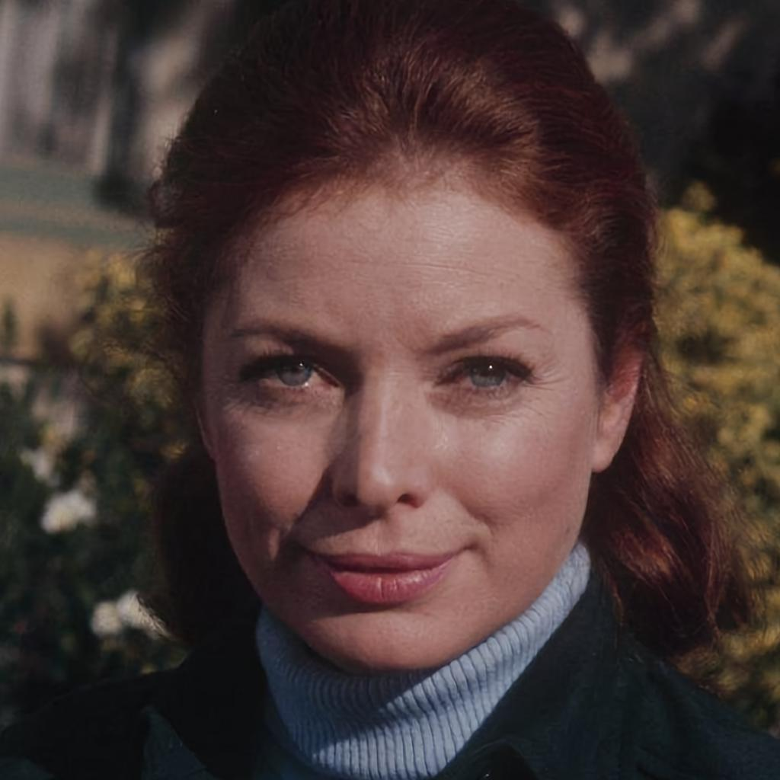
Face Recognition
Find and recognize face identities from images/videos by comparing against a face database.
Compare and match with closest face
Database of extracted face embeddings
Face Feature Extractor
Face Embedding
Part of Biometric-based recognition systems.
  Secure and adaptable to human preference.
  Device unlocking, Digital payments, etc.

Slide 6
Motivation 1
Current state-of-the-art (SOTA) face recognition systems integrate deep neural networks (NN).
  Require large and diverse training datasets.
  Some models too large for lightweight applications.
  Most NN-based solutions require high computational power, like GPUs.
Are these feasible for daily biometric applications?
Database of extracted face embeddings
Compare and match with closest face
Face Feature Extractor
Face Embedding

Slide 7
Face Recognition
Model exploration
“Require large and diverse training datasets.”
  Are pre-trained object recognition models capable of performing face recognition similarly to SOTA methods?
“Some models too large for lightweight applications.”
  How do lightweight face recognition models perform, when compared to deeper/larger models?

Slide 8
SOTA Face Recognition Solutions
Increasing number of parameters
 | EdgeFace ^{[1]} | AdaFace ^{[2]} | ResNet-101 ^{[3]} | ElasticFace ^{[4]} | VGG16 ^{[5]}
Architecture | EdgeFace-S (gamma=5) | ResNet-101 | - | ResNet-100 | -
Number of Parameters | 3.65M | ~44.55M | 44.55M | 65.2M | 138M
Pretraining Dataset | WebFace 12M and 4M ( Webface260M Subsets) | MS1MV2 (Version of MS-Celeb-1M) | ImageNet1K | MS1MV2 (Version of MS-Celeb-1M) | ImageNet1K
Similar base architecture
[1] A. George, C. Ecabert, H. O. Shahreza, K. Kotwal, and S. Marcel. Edgeface: Efficient face recognition model for edge devices. arXiv preprint arXiv:2307.01838, 2023. https://github.com/otroshi/edgeface
[2] M. Kim, A. K. Jain, and X. Liu. Adaface: Quality adaptive margin for face recognition. In Proceedings of the IEEE/CVF conference on computer vision and pattern recognition, pages 18750–18759, 2022. https://github.com/mk-minchul/AdaFace
[3] He, K., Zhang, X., Ren, S. and Sun, J., 2016. Deep residual learning for image recognition. In Proceedings of the IEEE conference on computer vision and pattern recognition (pp. 770-778). https://pytorch.org/vision/main/models/resnet.html
[4] F. Boutros, N. Damer, F. Kirchbuchner, and A. Kuijper. Elasticface: Elastic margin loss for deep face recognition. In Proceedings of the IEEE/CVF conference on computer vision and pattern recognition, pages 1578–1587, 2022. https://github.com/fdbtrs/ElasticFace
[5] Simonyan, K. and Zisserman, A., 2014. Very deep convolutional networks for large-scale image recognition. arXiv preprint arXiv:1409.1556. https://pytorch.org/vision/main/models/vgg.html

Slide 9
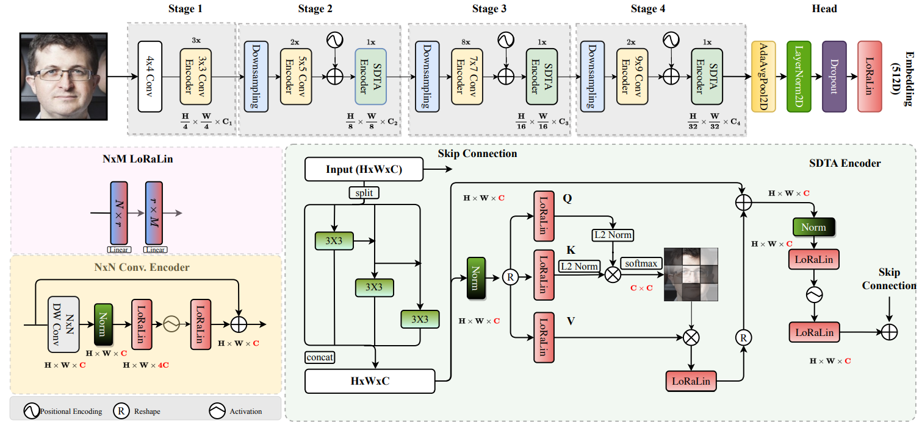
SOTA Face Recognition Solutions
EdgeFace ^{[1]}
Current SOTA in lightweight face recognition models.
  Replace all linear layers of EdgeNeXt architecture ^{[2]} with LoRaLin layers.
LoRaLin (Low Rank Linear) layer:
Based on Low-Rank Adaptation (LoRA) ^{[3]}.
Reduce number of parameters in linear layers.
[1] A. George, C. Ecabert, H. O. Shahreza, K. Kotwal, and S. Marcel. Edgeface: Efficient face recognition model for edge devices. arXiv preprint arXiv:2307.01838, 2023. https://github.com/otroshi/edgeface
[2] Maaz, M., Shaker, A., Cholakkal, H., Khan, S., Zamir, S.W., Anwer, R.M. and Shahbaz Khan, F., 2022, October. Edgenext: efficiently amalgamated cnn-transformer architecture for mobile vision applications. In European conference on computer vision (pp. 3-20). Cham: Springer Nature Switzerland.
[3] Hu, E.J., Shen, Y., Wallis, P., Allen-Zhu, Z., Li, Y., Wang, S., Wang, L. and Chen, W., 2021. Lora: Low-rank adaptation of large language models. arXiv preprint arXiv:2106.09685.

Slide 10
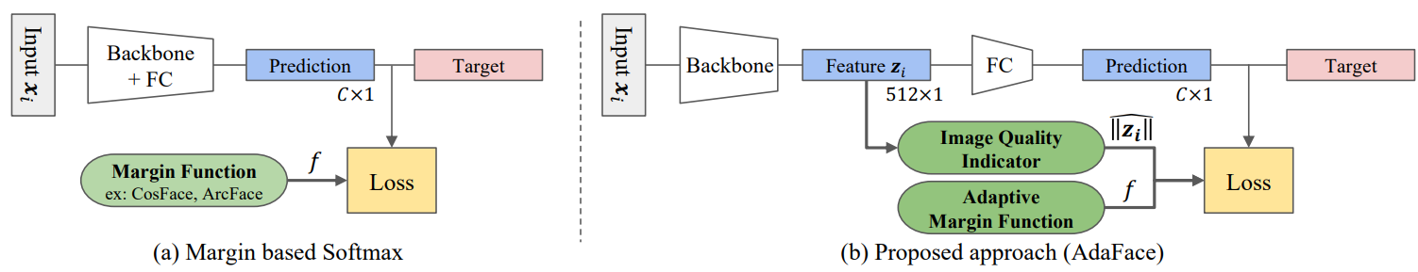
SOTA Face Recognition Solutions
AdaFace ^{[1]}
Current SOTA in training loss for low quality face recognition.
  Add weight corresponding to image quality – for images of low quality, emphasis on their misclassification is reduced.
    Learn facial features from high quality samples.
    Avoid learning vague background features from low quality faces to reduce loss.
[1] M. Kim, A. K. Jain, and X. Liu. Adaface: Quality adaptive margin for face recognition. In Proceedings of the IEEE/CVF conference on computer vision and pattern recognition, pages 18750–18759, 2022. https://github.com/mk-minchul/AdaFace

Slide 11
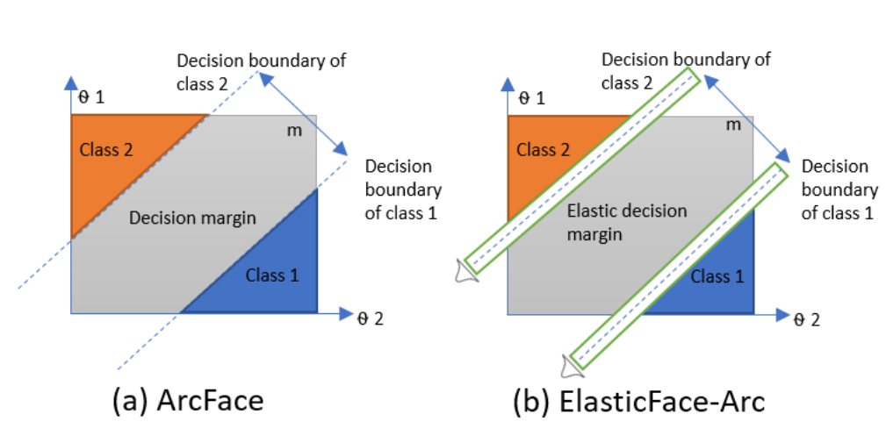
SOTA Face Recognition Solutions
ElasticFace ^{[1]}
Current SOTA in training loss for general face recognition.
  Use flexible margins during each training iteration for margin-based losses (CosFace and ArcFace).
    Margins derived from normal distribution.
[1] F. Boutros, N. Damer, F. Kirchbuchner, and A. Kuijper. Elasticface: Elastic margin loss for deep face recognition. In Proceedings of the IEEE/CVF conference on computer vision and pattern recognition, pages 1578–1587, 2022. https://github.com/fdbtrs/ElasticFace

Slide 12
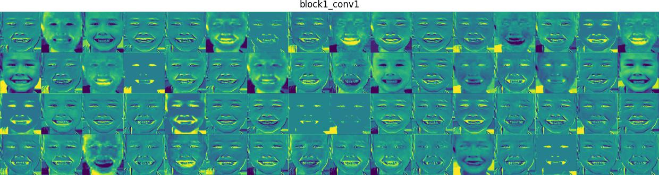
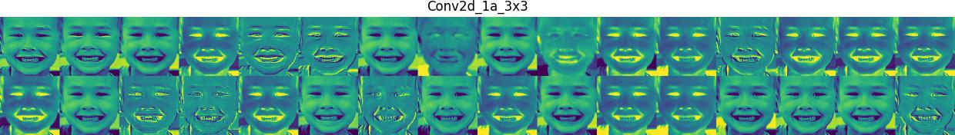
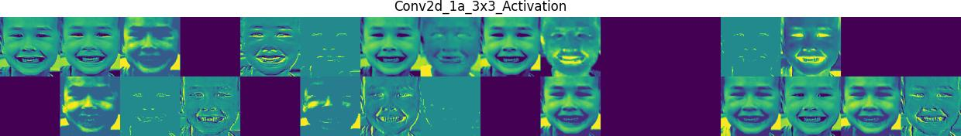
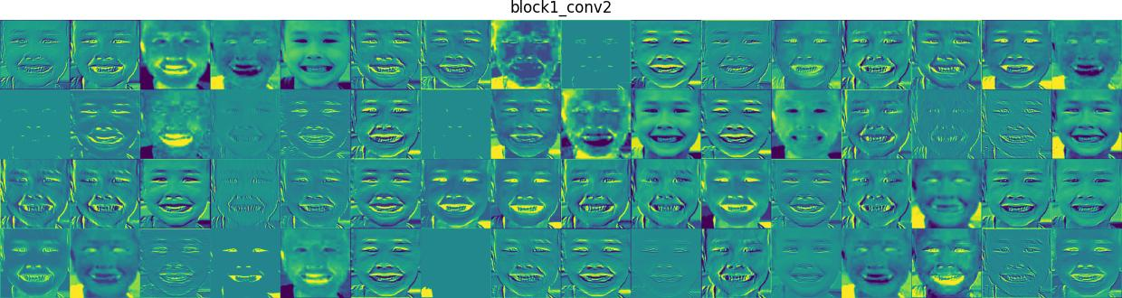
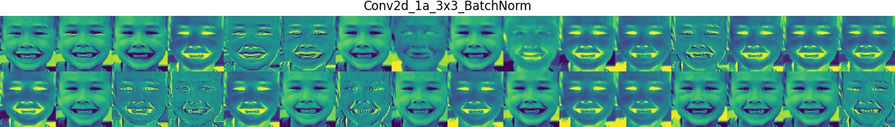
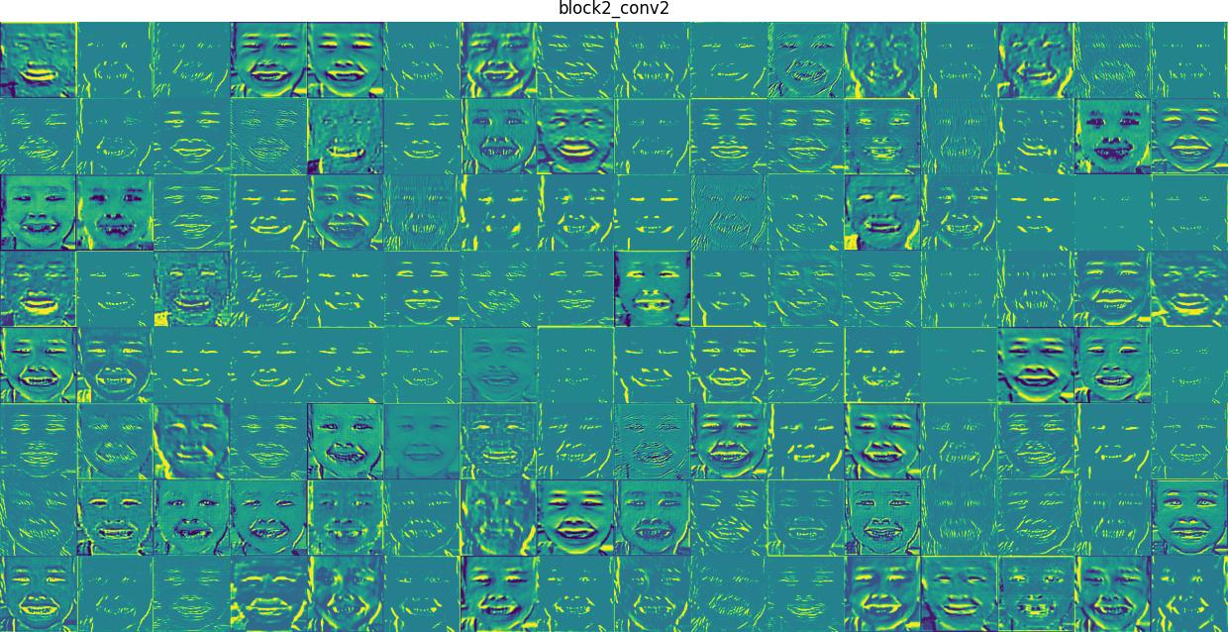
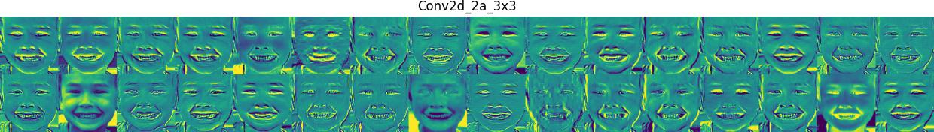
Features visualization
VGG16 Features
FaceNet Features

Slide 13
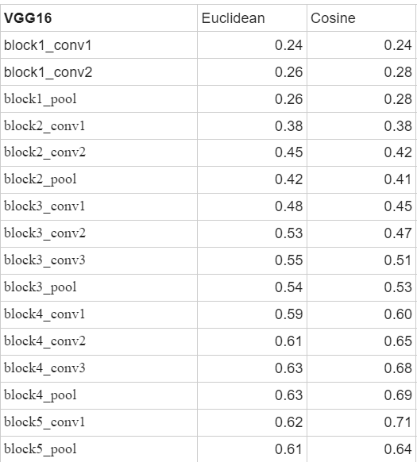
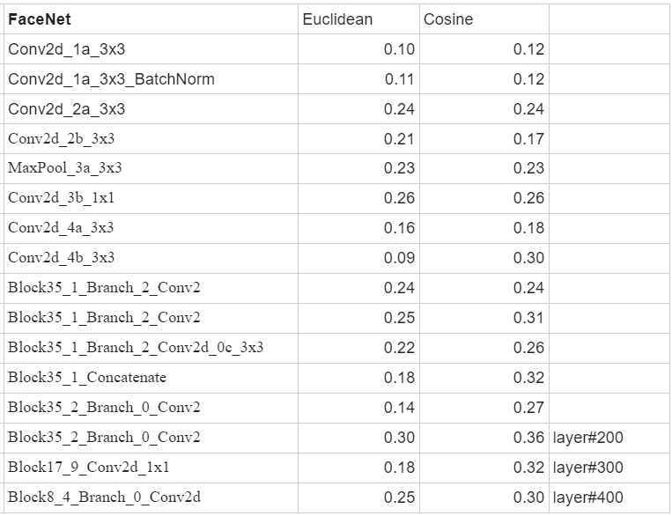
Intermediate Feature as Face Embeddings for Recognition
The second last layer performance of FaceNet is Euclidean = 0.51 and Cosine = 0.54.

Slide 14
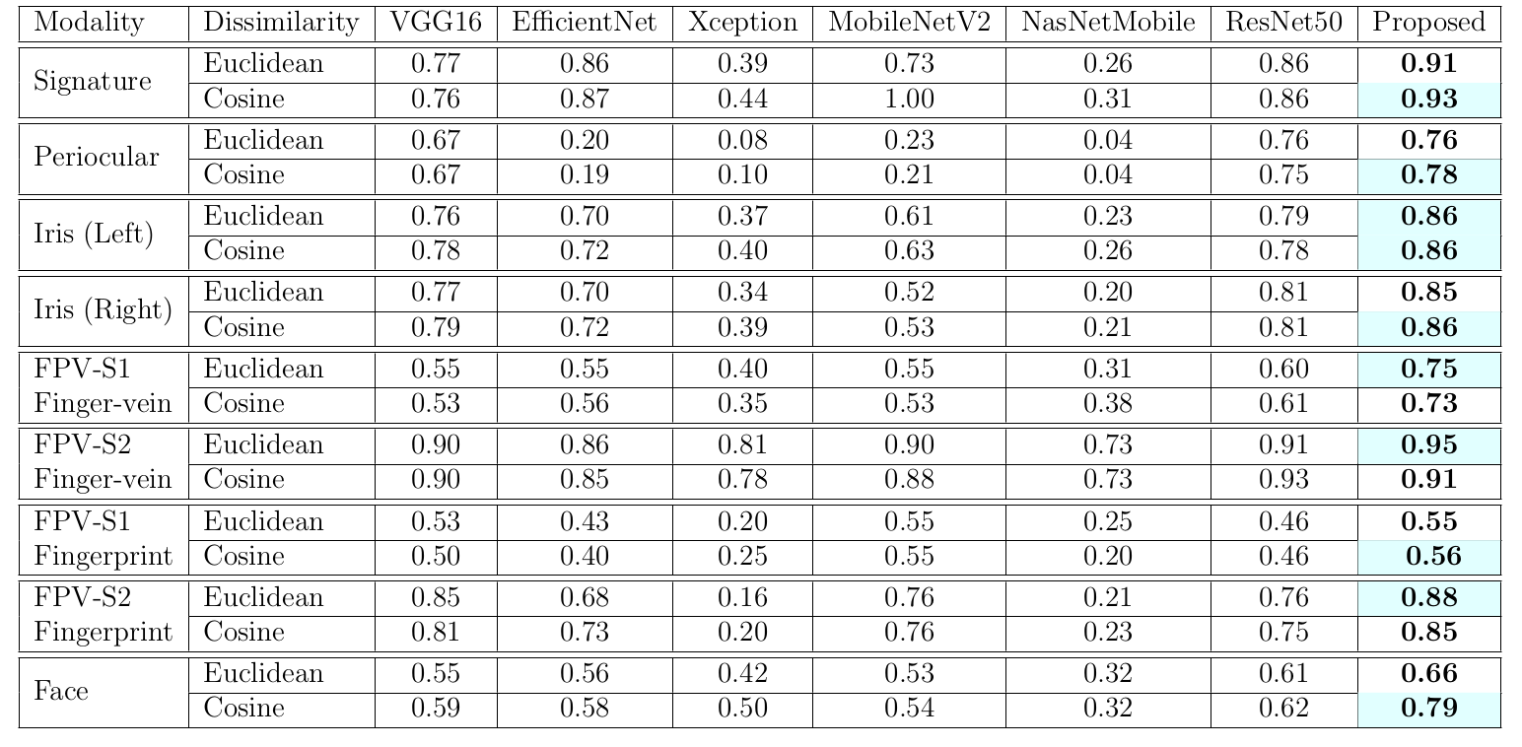
Experimental results
Table 3: CIR score [0-1] of the pre-trained CNNs along with the proposed fusion algorithm.
Proposed fusion architecture drastically boost the recognition performance.
It shows that pre-trained models can be utilized effectively for biometric recognition.
ResNet50 outperforms all other pre-trained networks except for Fingerprint modality.
For our proposed fusion algorithm cosine metric yields 5 times out of 7 better accuracies than euclidean.
Are Object Recognition Models Effective and Unbiased for Biometric Recognition?, IJCB 2024

Slide 15
Motivation 2
Model performance usually varies based on distribution shift between training and testing datasets.
  Real faces are predominantly used for training SOTA recognition models ^{[1]}.
“Are face recognition model performances similar when tested with Synthetic and Adversarial data distributions?”
[1] Huber, M., Luu, A.T., Boutros, F., Kuijper, A. and Damer, N., 2024. Bias and diversity in synthetic-based face recognition. In Proceedings of the IEEE/CVF Winter Conference on Applications of Computer Vision (pp. 6215-6226).

Slide 16
Datasets
Dataset | Type | Orig. Image Size | Number of IDs* | Number of Images*
CPLFW | Real | 224 x 224 | 3787 | 10272
CALFW |  | 224 x 224 | 2435 | 8935
Celeb-A |  | 178 x 218 | 3548 | 26033
Celeb-A-HQ | Real (Inverted from GAN space) | 1024 x 1024 | 3548 | 26062
BFW (Balanced Faces in Wild) | Real | 108 x 124 | 800 [4 Races x 2 Genders : 100 IDs per] | 25
DigiFace-1M | Synthetic | 112 x 112 | 3000 | 3+
SynFace |  | 96 x 112 | 3000 | 3+
SynthASpoof | Adversarial | 256 x 256 | iPad Replay: 24998 Samsung Replay: 24999 Webcam Replay: 25000 Print Attack: 3800 | Pairs (Bonafide, Adversarial)
*Used in experiments.

Slide 17
Datasets
Download links:
  CelebA: http://mmlab.ie.cuhk.edu.hk/projects/CelebA.html
  CALFW: http://www.whdeng.cn/CALFW/?reload=true
  CPLFW: http://www.whdeng.cn/cplfw/?reload=true
  Balanced Faces in the Wild (BFW): https://github.com/visionjo/facerec-bias-bfw
  DigiFace1M: https://github.com/microsoft/digiface1m
  SynFace: https://github.com/haibo-qiu/SynFace
  SynthASpoof: https://github.com/meilfang/SynthASpoof

Slide 18
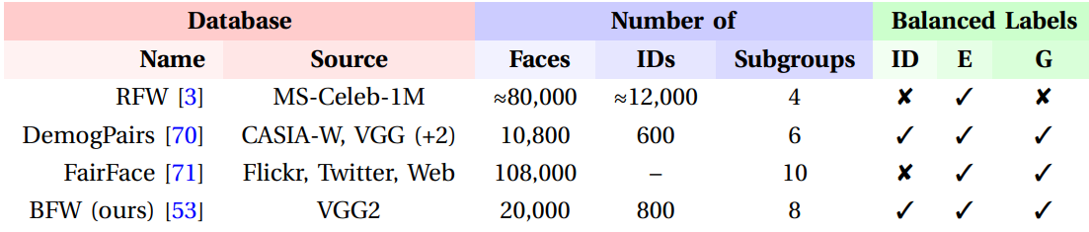
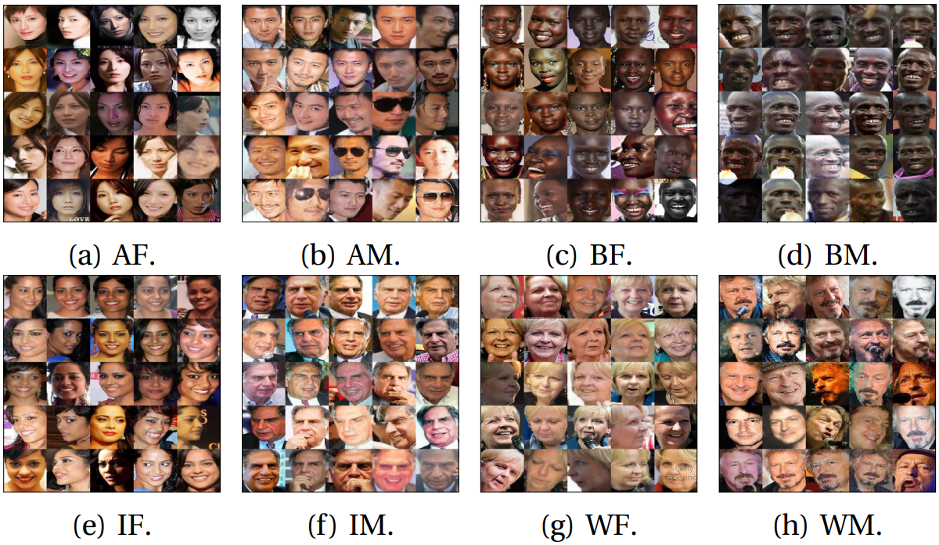
BFW: Balanced Faces in the Wild

Slide 19
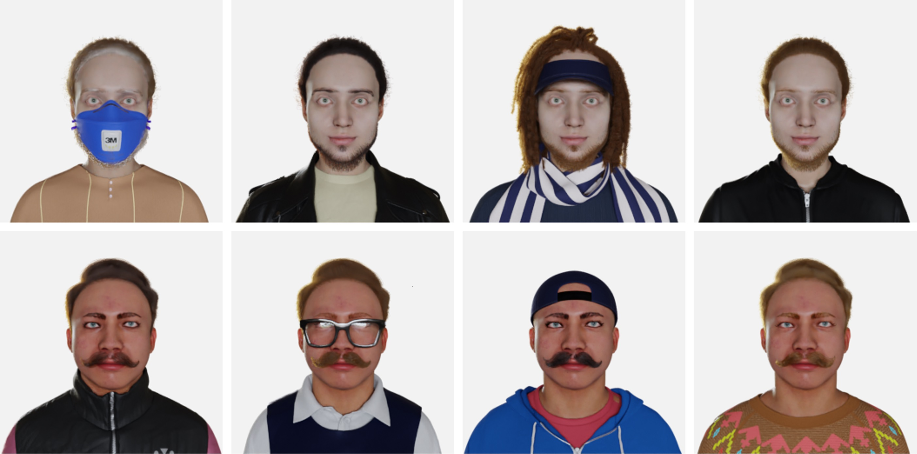
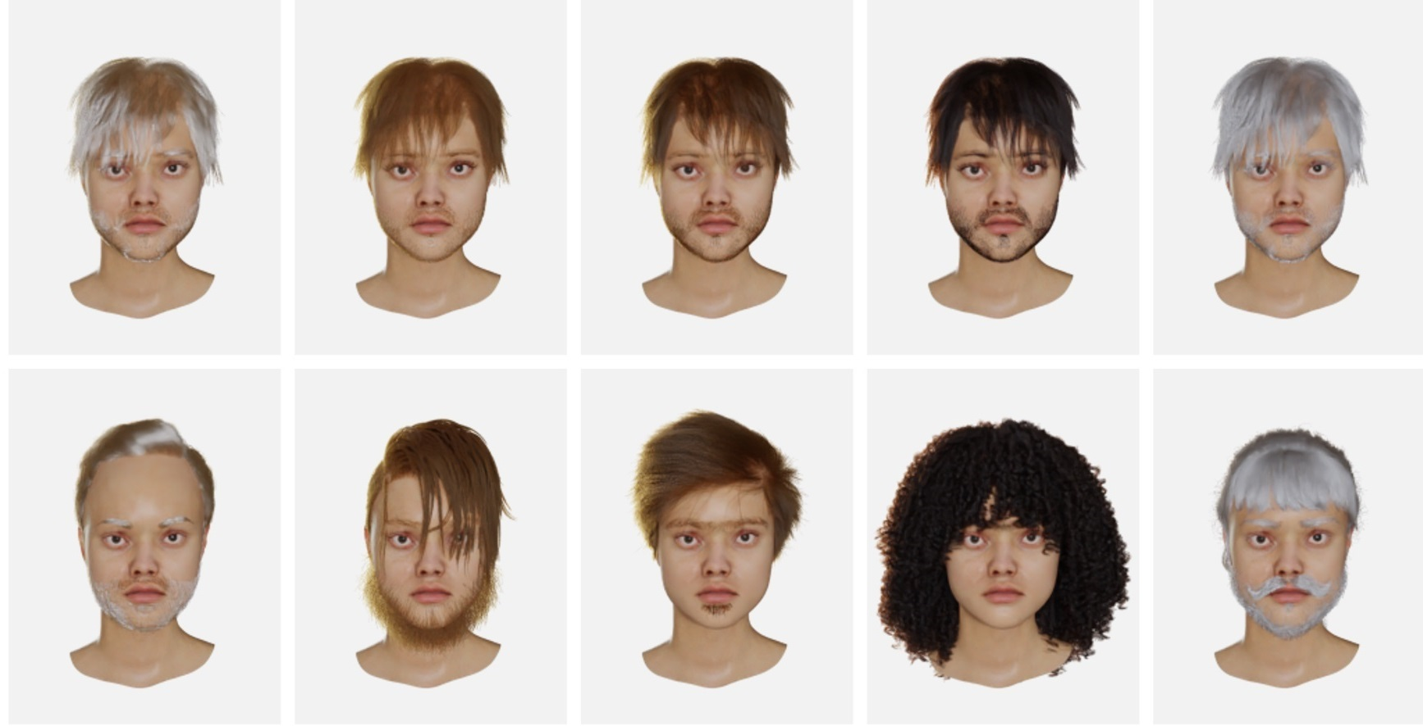
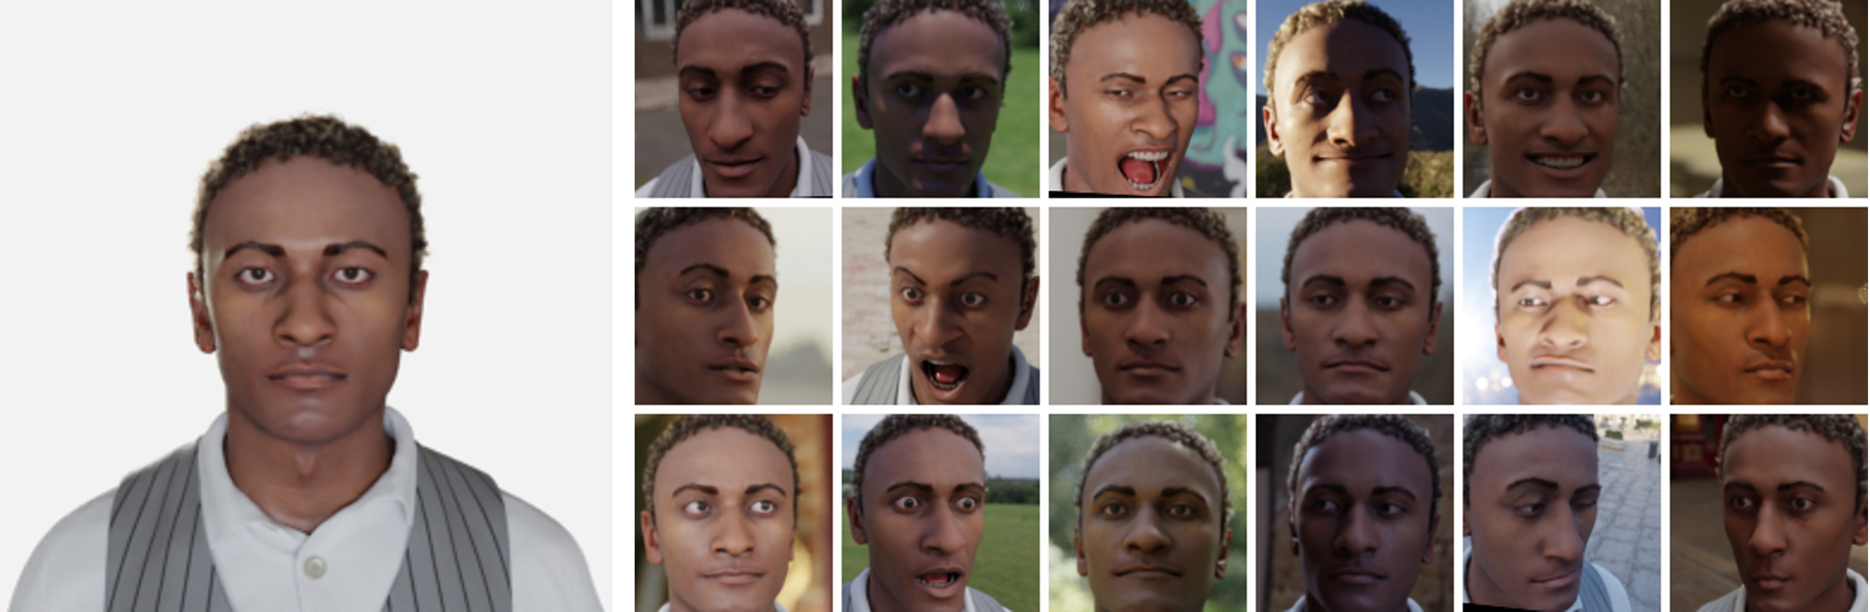
DigiFace-1M
1M synthetic faces generated extending method proposed in [1].
  Identity: Unique combination of facial geometry, texture, eye color and hair style.
  Accessories: Combination of clothing, make-up, glasses, face-wear and head-wear.
[1] Wood, E., Baltrušaitis, T., Hewitt, C., Dziadzio, S., Cashman, T.J. and Shotton, J., 2021. Fake it till you make it: face analysis in the wild using synthetic data alone. In Proceedings of the IEEE/CVF international conference on computer vision (pp. 3681-3691).

Slide 20
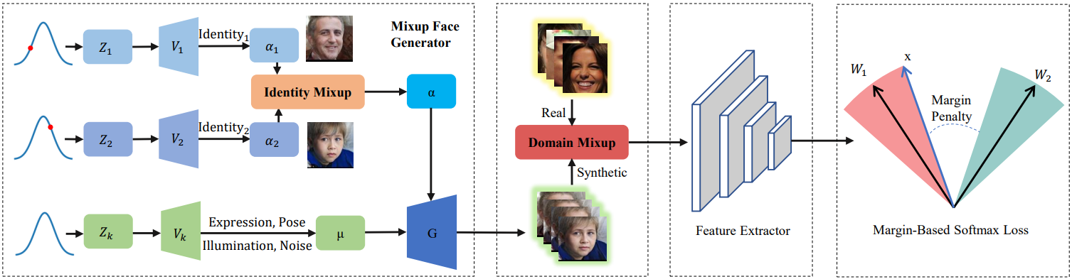
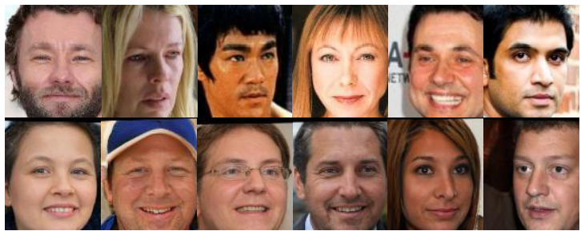
SynFace
Method to mix real identities, forming new ones.
Real
Synthetic (SynFace)

Slide 21
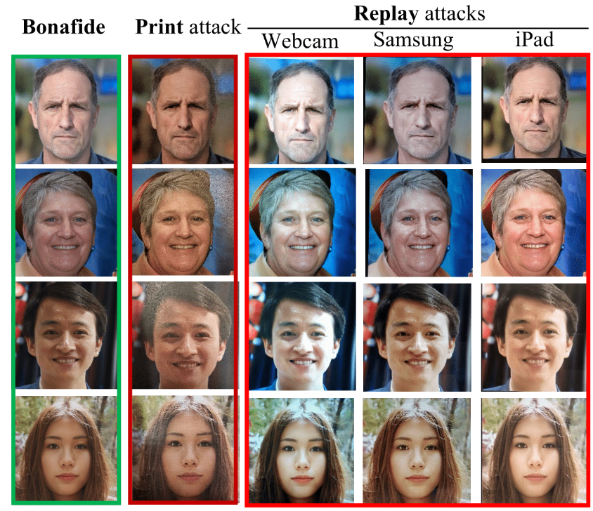
SynthASpoof
Synthetic-based face presentation attack detection datasets.
  Collected by presenting the printed/replayed images to capture cameras (one mobile phone, two different tablets, and one webcam).

Slide 22
Face Recognition Progression
Model Exploration over
Datasets of
Different Distributions
Motivations, Models, Datasets.
Model Exploration over
Datasets of Different Distributions.
Face Recognition Performance and Analysis on Real Datasets.
Face Recognition Performance and Analysis on Synthetic Datasets.
Face Recognition Performance and Analysis on Morphed Faces.
Face Recognition Performance and Analysis on Adversarial Datasets.

Slide 23
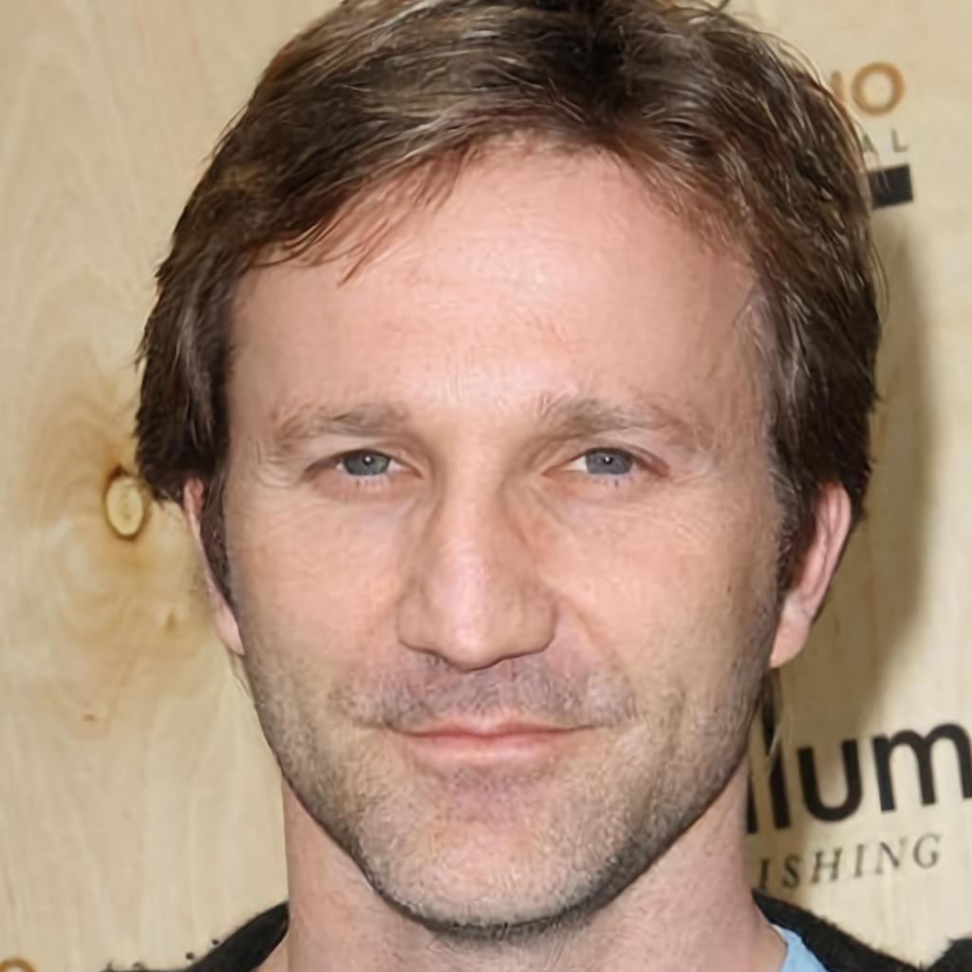
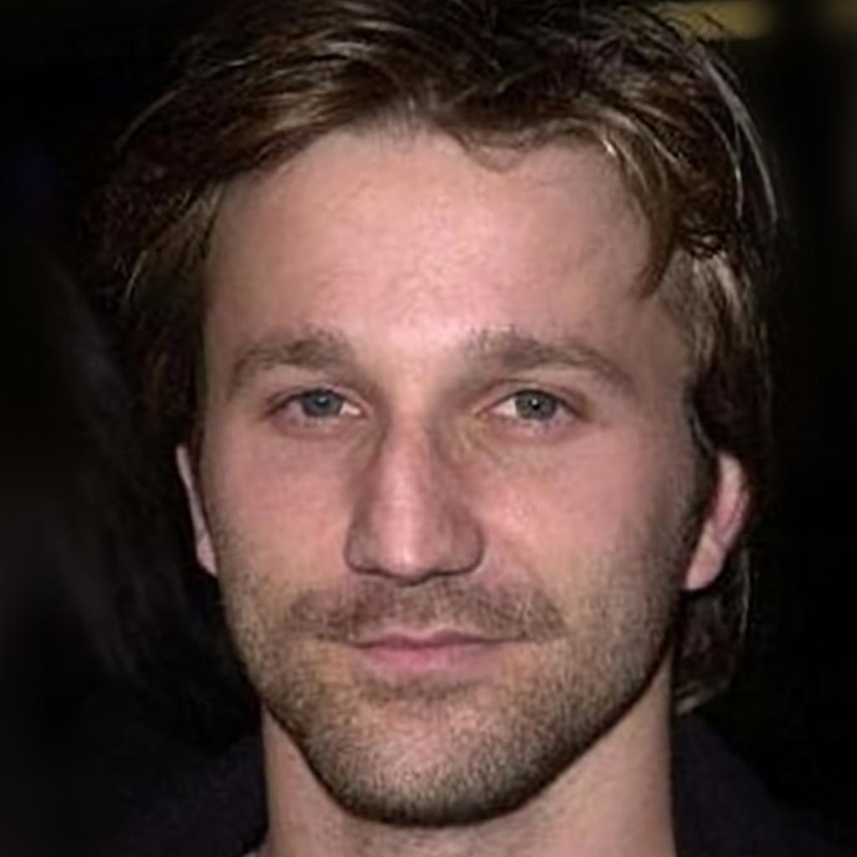
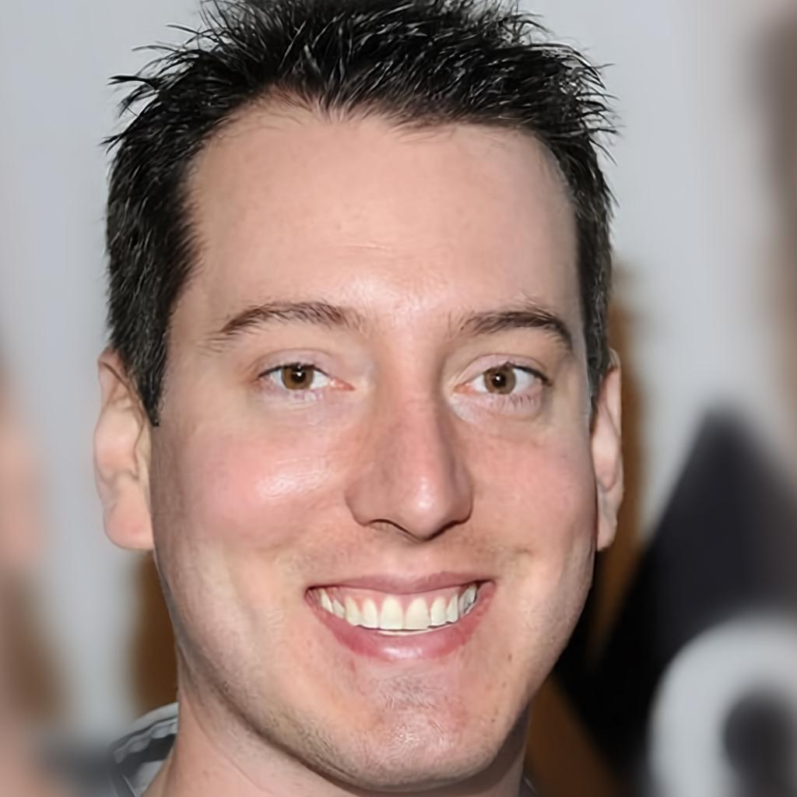
Evaluation for Face Recognition
Accuracy score.
  Compare face embedding with embeddings from dataset, find the closest match for ID prediction (cosine similarity), and check if prediction is correct [match with GT ID].
  For datasets with face pairs (e.g., SynthASpoof has “bonafide – Adversarial” pairs), we use a fixed threshold to get correct/incorrect samples, then calculating accuracy scores.
Similar Embeddings
Dis-similar Embeddings
[1] https://pytorch.org/docs/stable/generated/torch.nn.CosineSimilarity.html

Slide 24
Visualizing Embeddings Extracted from Models
UMAP ^{[1]}: Non-linear dimension reduction algorithm (Preserve data structure).
Parameters.
  n_neighbors (5): For local dataset structure, we select a smaller number.
  min_dist (0.01): Determines clustering density.
  n_components (2): Represent dataset embeddings in 2 dimensions.
  metric (cosine): Cosine Similarity to determine closeness of 2 embeddings.
[1] https://umap-learn.readthedocs.io/en/latest/parameters.html

Slide 25
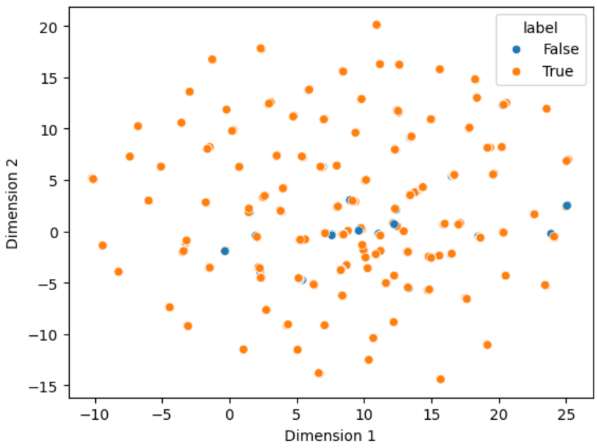
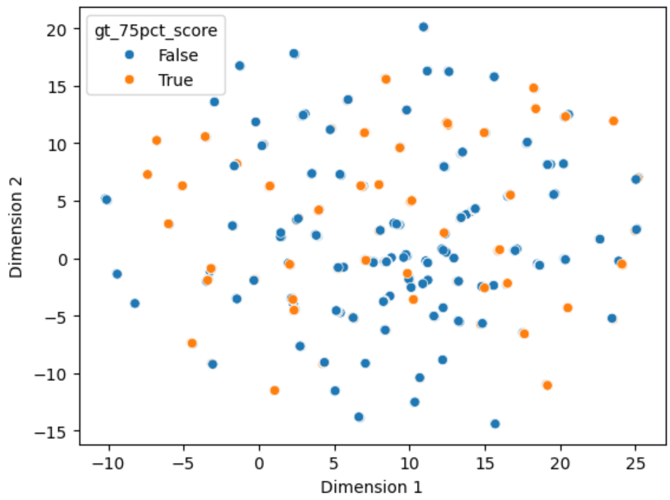
Visualizing Embeddings Extracted from Models

Slide 26
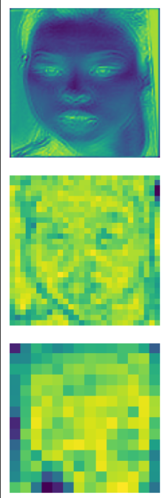
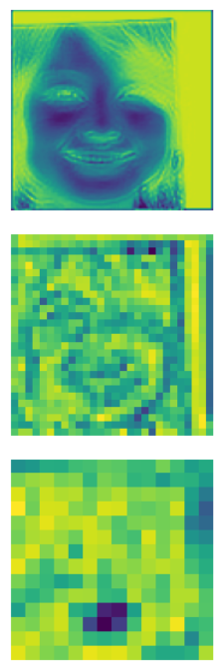
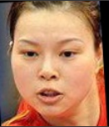
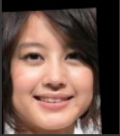
Visualizing Biometric Feature Embeddings from Convolutional Layers

Slide 27
Face Recognition Progression
Face Recognition Performance and Analysis on
Real Datasets
Motivations, Models, Datasets.
Model Exploration over
Datasets of Different Distributions.
Face Recognition Performance and Analysis on Real Datasets.
Face Recognition Performance and Analysis on Synthetic Datasets.
Face Recognition Performance and Analysis on Morphed Faces.
Face Recognition Performance and Analysis on Adversarial Datasets.

Slide 28
Balanced Face Distribution
Dataset: BFW
 |  | # Samples | EdgeFace | AdaFace | ResNet-101 | ElasticFace | VGG16
Indian | Female | 2479 | 96.21% | 96.81% | 7.87% | 96.57% | 8.71%
White |  | 2454 | 98.41% | 98.61% | 8.68% | 98.70% | 11.61%
Black |  | 2477 | 97.05% | 97.74% | 7.55% | 97.74% | 9.93%
Asian |  | 2465 | 93.67% | 95.33% | 6.57% | 95.09% | 7.71%
Avg. ±SD |  | - | 96.34 ±1.99 (%) | 97.12 ±1.40 (%) | 7.67 ±0.87 (%) | 97.03 ±1.56 (%) | 9.49 ±1.68 (%)
Indian | Male | 2446 | 95.87% | 96.24% | 11.53% | 96.03% | 13.61%
White |  | 2459 | 98.86% | 98.90% | 11.59% | 99.02% | 14.19%
Black |  | 2468 | 95.79% | 95.95% | 11.02% | 95.99% | 11.18%
Asian |  | 2460 | 94.84% | 95.81% | 9.96% | 95.73% | 12.28%
Avg. ±SD |  | - | 96.34 ±1.74 (%) | 96.73 ±1.46 (%) | 11.03 ±0.75 (%) | 96.69 ±1.56 (%) | 12.82 ±1.35 (%)

Slide 29
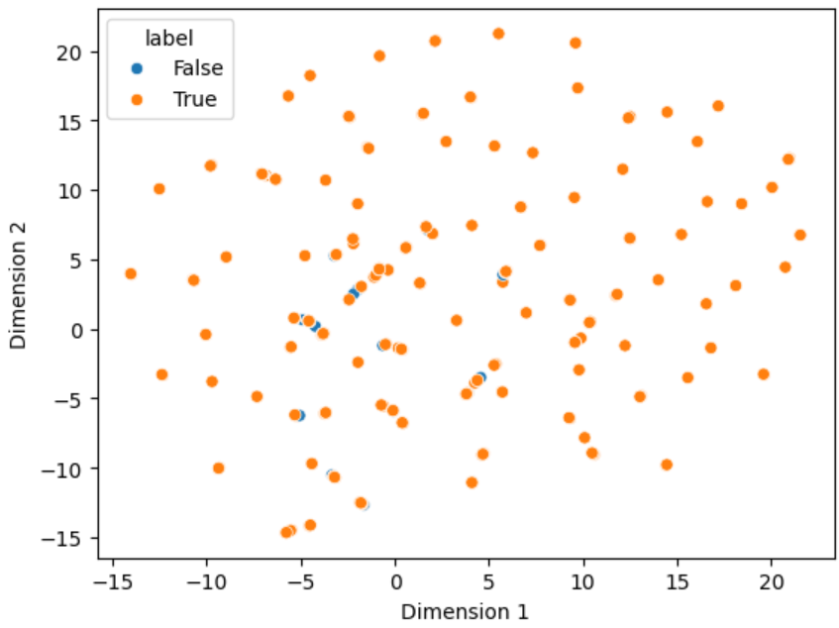
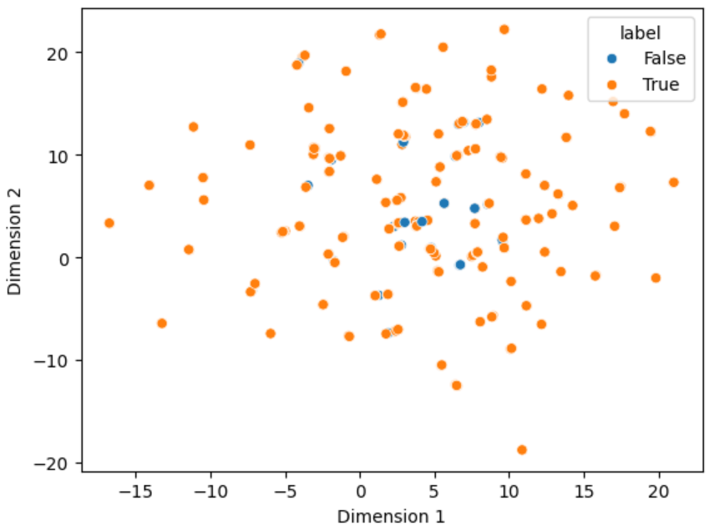
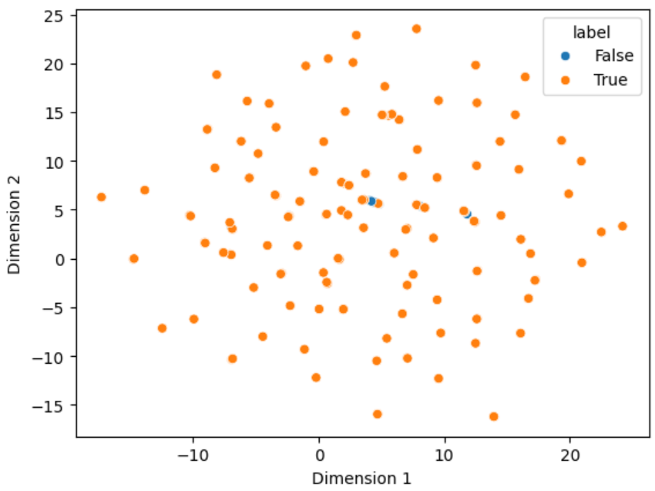
Balanced Face Distribution
Dataset: BFW
Feature distributions (adaface_ir101_ms1mv2)
black_females
black_males
white_males

Slide 30
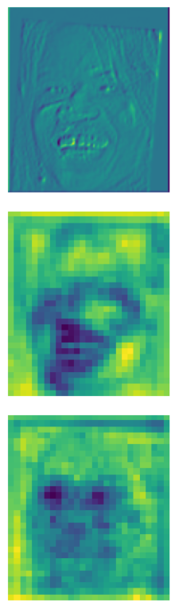
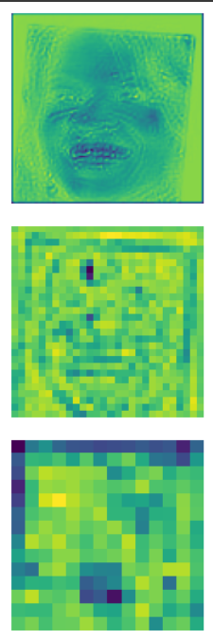
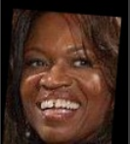
Balanced Face Distribution
Dataset: BFW
AdaFace
ResNet-101
Top performer for AdaFace

Slide 31
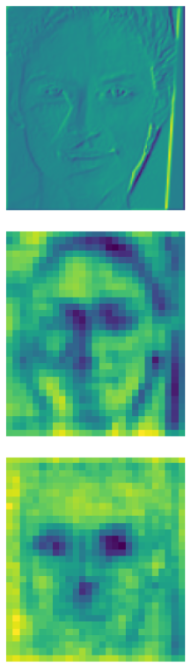
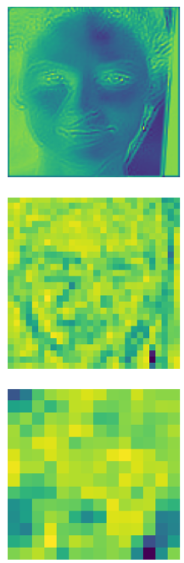
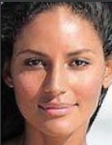
Balanced Face Distribution
Dataset: BFW
AdaFace
ResNet-101
Top performer for ResNet-101

Slide 32
Comparisons, based on
Lightweight face recognition models not as good, but good alternative for cheaper resource requirements
Quality
 | # Samples | Quality Score^{[1]} (Avg. ±SD) | EdgeFace | AdaFace | ResNet-101 | ElasticFace | VGG16
Celeb-A | 26033 | 0.2887 ±0.1210 | 96.53% | 97.10% | 10.29% | 97.15% | 11.91%
Celeb-A-HQ | 26062 | 0.5272 ±0.0980 | 96.69% | 97.22% | 11.02% | 97.23% | 13.28%
Age
 | # Samples | EdgeFace | AdaFace | ResNet-101 | ElasticFace | VGG16
CALFW | 8935 | 96.90% | 97.55% | 0.02% | 97.46% | 0.02%
Pose
 | # Samples | EdgeFace | AdaFace | ResNet-101 | ElasticFace | VGG16
CPLFW | 10272 | 82.26% | 87.79% | 0.01% | 87.34% | 0.01%
[1] Babnik, Ž., Peer, P. and Štruc, V., 2022, August. FaceQAN: Face image quality assessment through adversarial noise exploration. In 2022 26th International Conference on Pattern Recognition (ICPR) (pp. 748-754). IEEE. https://github.com/LSIbabnikz/FaceQAN

Slide 33
Face Recognition Progression
Face Recognition Performance and Analysis on
Synthetic Datasets
Motivations, Models, Datasets.
Model Exploration over
Datasets of Different Distributions.
Face Recognition Performance and Analysis on Real Datasets.
Face Recognition Performance and Analysis on Synthetic Datasets.
Face Recognition Performance and Analysis on Morphed Faces.
Face Recognition Performance and Analysis on Adversarial Datasets.

Slide 34
Comparing Performance:
Real vs Synthetic Data Distributions
#IDs: 3000, # Images: 9000
 | Type | EdgeFace | AdaFace | ElasticFace
Celeb-A-HQ | Real | 96.64% | 97.18% | 97.22%
CPLFW |  | 81.96% | 87.76% | 87.17%
DigiFace-1M | Synthetic | 96.73% | 99.10% | 98.97%
SynFace |  | 25.36% | 27.68% | 28.21%

Slide 35
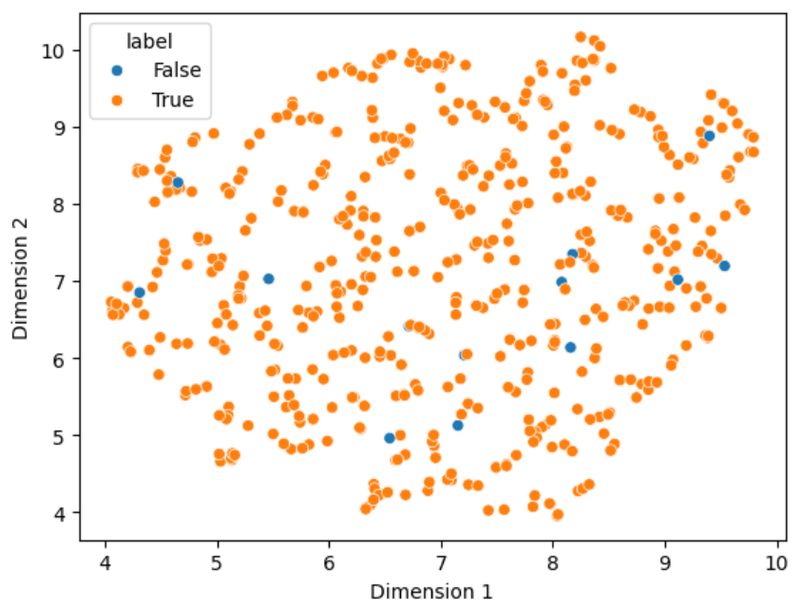
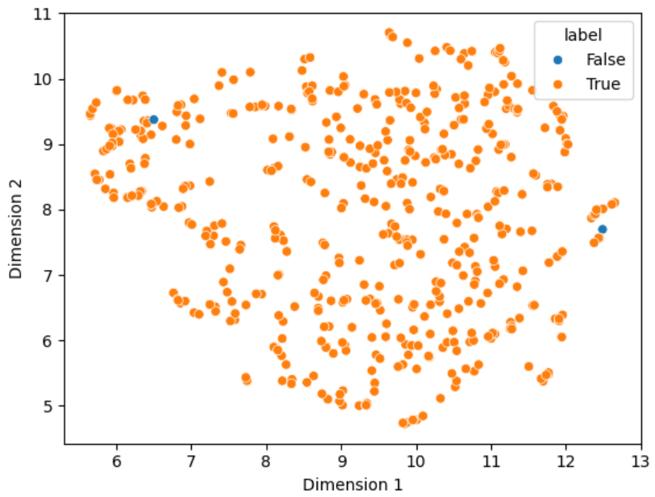
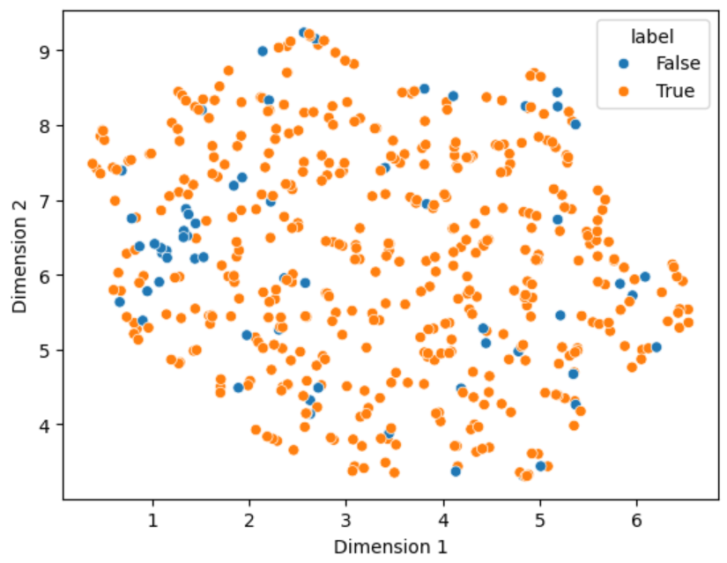
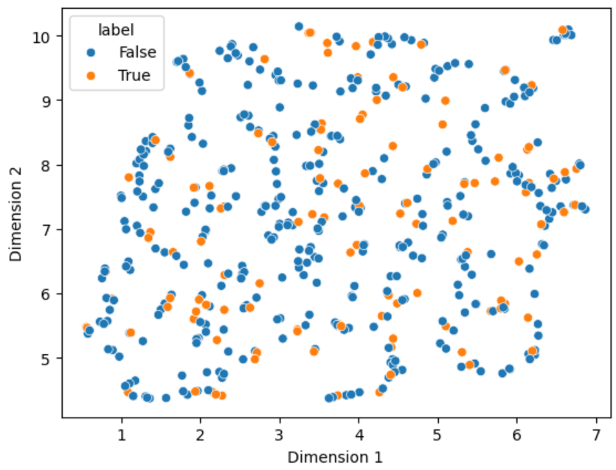
Comparing Performance:
Real vs Synthetic Data Distributions
Feature distributions (adaface_ir101_ms1mv2)
CelebA-HQ
DigiFace1M
CPLFW
SynFace

Slide 36
Face Recognition Progression
Face Recognition Performance and Analysis on
Morphed Faces
Motivations, Models, Datasets.
Model Exploration over
Datasets of Different Distributions.
Face Recognition Performance and Analysis on Real Datasets.
Face Recognition Performance and Analysis on Synthetic Datasets.
Face Recognition Performance and Analysis on Morphed Faces.
Face Recognition Performance and Analysis on Adversarial Datasets.

Slide 37
Morphed Faces
IMPUS ^{[1]} Morphed
Embedding Similarity threshold between (original, morph) pairs = 0.6
 | # Samples | EdgeFace | AdaFace | ResNet-101 | ElasticFace | VGG16
Male | 900 | 36.89% | 4.89% | 99.89% | 3.33% | 95.33%
Female | 899 | 26.59% | 4.12% | 99.89% | 2.56% | 97.33%
[1] https://github.com/gol2022/impus

Slide 38
Face Recognition Progression
Face Recognition Performance and Analysis on
Adversarial Datasets
Motivations, Models, Datasets.
Model Exploration over
Datasets of Different Distributions.
Face Recognition Performance and Analysis on Real Datasets.
Face Recognition Performance and Analysis on Synthetic Datasets.
Face Recognition Performance and Analysis on Morphed Faces.
Face Recognition Performance and Analysis on Adversarial Datasets.

Slide 39
Adversarial
SynthASpoof [1]
Embedding Similarity threshold between (original, adversarial) pairs = 0.85
 | # Samples | EdgeFace | AdaFace | ResNet-101 | ElasticFace | VGG16
Webcam Replay Attack | 24949 | 99.46% | 99.56% | 99.19% | 99.05% | 83.10%
Samsung Replay Attack | 24960 | 98.79% | 97.82% | 98.83% | 95.06% | 56.49%
IPad Replay Attack | 24964 | 99.86% | 99.89% | 99.73% | 99.80% | 86.21%
Print Attack | 3794 | 69.03% | 46.94% | 82.13% | 30.60% | 28.57%

